Slide 1
Automatic Summarization Of Legal Texts
Group 9
Members
Vishal Raj (17EE10055)
Ritam Talukder (17EE30023)
Sujabrata Mallick (17IE10037)
Mentor
Paheli Bhattacharya

Slide 2
Problem Statement
Unsupervised Extractive Legal Document Summarization
To generate two summaries using maximum marginal reference for each full document in a collection of 50 , using two reference summaries of different lengths for each document.
To calculate the average rogue scores for each set of summary for the collection

Slide 3
Approach towards solution
We used the tf-idf vectorizer over the list of splitted documents, so that we can use that to obtain the tf-idf of a sentence.We obtain each sentence as a vector with unique words as columns.
We then computed the similarities between each pair of sentences in the document and stored it in a 2-D array by computing the dot product of two vectors. For each sentence the maximum similarity was thus found by comparing the values for that sentence with other sentences by using the precomputed similarity values.
We applied the Maximum Marginal Relevance(MMR) algorithm to find the summary as it increases the relevance of the sentences that are being added to the summary as well as reduce the redundancy
We iterated through all the sentences in the document and found the maximum marginal relevance score of all the sentences and updated the summary by adding the sentence with the maximum marginal relevance score.

Slide 4
Approach towards solution
We kept on adding sentences to the summary unless it crossed a particular threshold which was passed as a parameter.
We read the files and generated the 2 summaries based on the reference summaries A1 and A2 for 3 values of λ: 0.3, 0.5, 0.7.
We calculate the rogue scores for all the generated summaries with respect to the reference summaries and store the rogue-1,rogue-2,rogue-l scores in rogue.txt. Rouge score helps us to assess the adequacy of the summary by simply counting how many n-grams in your generated summary matches n-grams in our reference summary.
We calculate and display the average of rogue scores of 50 documents at the end.

Slide 5
Algorithm
Divide the case document into sentences, each sentence being a separate document.
Initialize summary to be empty.
While the word count is below the desired word count we add to summary the sentence (From a given ‘List of sentences’ = Case document in our case) with ‘maximal MMR (Maximal Marginal Relevance) score’.
MMR score = F(Sentence_to_be_added,Case_document)*λ - F(Sentence_to_be_added,Summary)*(1-λ).
Here F(Sentence_to_be_added,Some_document) = { i>= 0 and i < len(Some_document) } max(Similarity(Sentence_to_be_added,Some_document[i]))

Slide 6
Representation of the task
Reference Summary A1
Reference Summary A2
Full Document
λ=0.3
λ=0.5
λ=0.7
λ=0.7
λ=0.3
λ=0.5
Generated Summary 1
Generated
Summary 2
Generated Summary 3
Generated Summary 1
Generated Summary 2
Generated Summary 3
The summaries have been generated using Maximum Marginal Relevance where λ is a hyperparameter.

Slide 7
Results Obtained

Slide 8
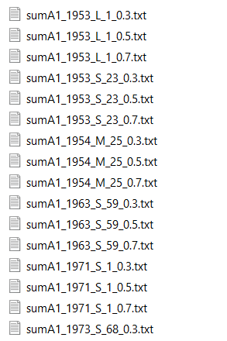
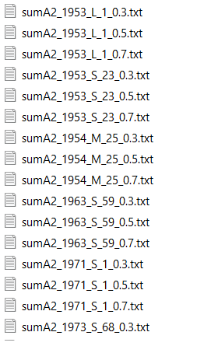
Generated summary files for A1 and A2 summary sets
Generated Summary file list for A1 reference
Generated Summary file list with A2 reference

Slide 9
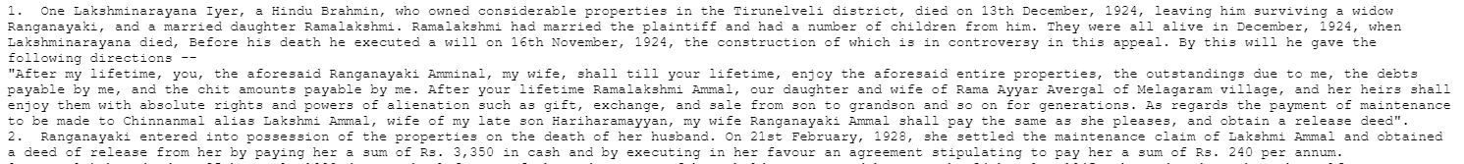
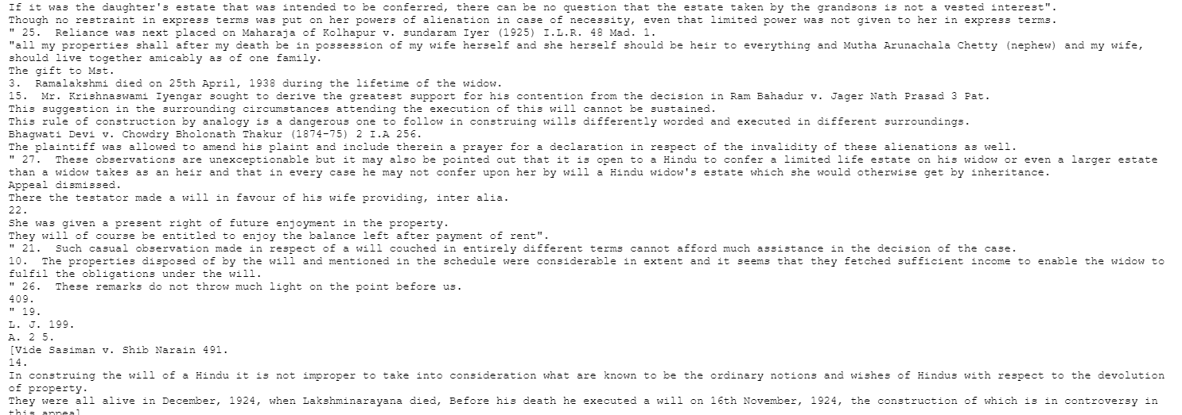
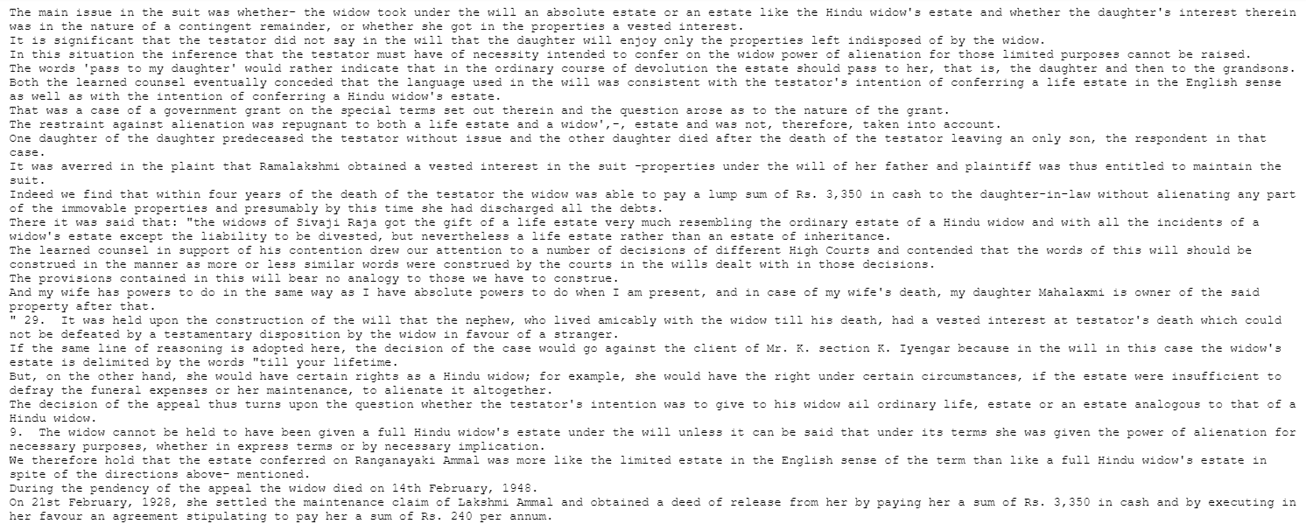
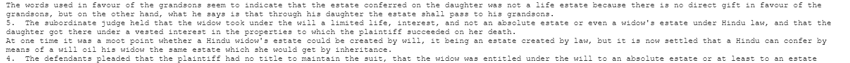
Generated summaries for lambda=0.3 , 0.5 , 0.7 for a particular document as A1 reference
Original full document-(1953_L_1.txt)
Generated summary Lambda=0.3 (sumA1_1953_L_1_0.3.txt)
Generated summary Lambda=0.5(sumA1_1953_L_1_0.5.txt)
Generated summary Lambda=0.7(sumA1_1953_L_1_0.7.txt)

Slide 10
Average Rogue scores for each set of summary (A1 and A2)
Rouge score average for A1 Summary :-
 | Rouge-1 | Rouge-2 | Rouge-l
F-Score | 0.5033 | 0.2859 | 0.3857
precision | 0.5006 | 0.2843 | 0.5525
recall | 0.5062 | 0.2876 | 0.3899
Rouge score average for A2 Summary :-
 | Rouge-1 | rouge-2 | rouge-l
F-Score | 0.3464 | 0.1709 | 0.2506
precision | 0.3474 | 0.1716 | 0.6542
recall | 0.3460 | 0.1704 | 0.2214
Note:- In most documents we obtain ‘High’ rouge scores ( >= 0.5 ).
Only some documents had a ‘Low’ score ( < 0.3 ). This distorted the average very much.

Slide 11
Thank You

